Slide 1
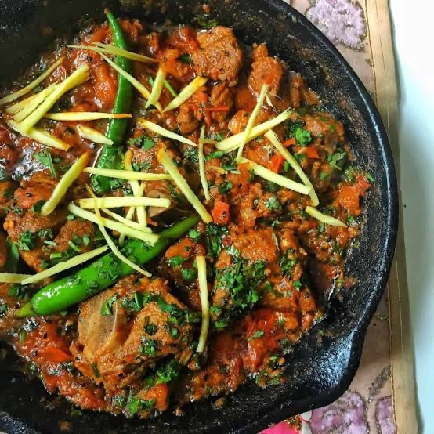
EONOVATE TECH · RESTAURANT POS
Desi Dhaba POS
A modern, menu-book style point of sale built for Desi & Asian restaurants — with real dish photos, FBR-ready invoicing, and built-in analytics.
Sales Team Briefing
Prepared for the EONOVATE Tech sales team

Slide 2
THE OPPORTUNITY
Desi restaurants deserve better than a repainted fast-food POS
Most POS systems sold to Pakistani restaurants are generic fast-food templates. That's a mismatch — and an opening.
1
2
3
4
No real menu photos
No ingredient info
Bolted-on tax compliance
No kitchen-level insight
Generic icons or none at all — customers can't see what Sajji or Chicken Karahi actually looks like.
Walk-in customers and new staff have no easy way to see what's in a dish before ordering.
FBR digital invoicing is treated as an afterthought, not a core, mock-and-test-ready workflow.
Owners can't see best sellers, bread consumption, or average bill without a spreadsheet.
Desi Dhaba POS · EONOVATE Tech
2

Slide 3
THE PRODUCT
Everything a Desi or Asian restaurant needs, out of the box
Front of House
Back of House
Menu-book ordering screen — big real photos + ingredients beside every dish
FBR digital invoicing — mock mode for demos, real mode when credentials are ready
Category tabs, live search, and half/full size pricing for Karahi, Sajji & more
Thermal receipt printing (ESC/POS) with an HTML fallback when no printer is attached
Cash and card checkout with automatic tax calculation
Analytics dashboard: best sellers, average bill, items per order, bread per order
Admin > Menu: add items, upload pictures, and edit ingredients — no code required
Role-based logins (admin/cashier) and a separate super-admin gate for sensitive settings
Desi Dhaba POS · EONOVATE Tech
3

Slide 4
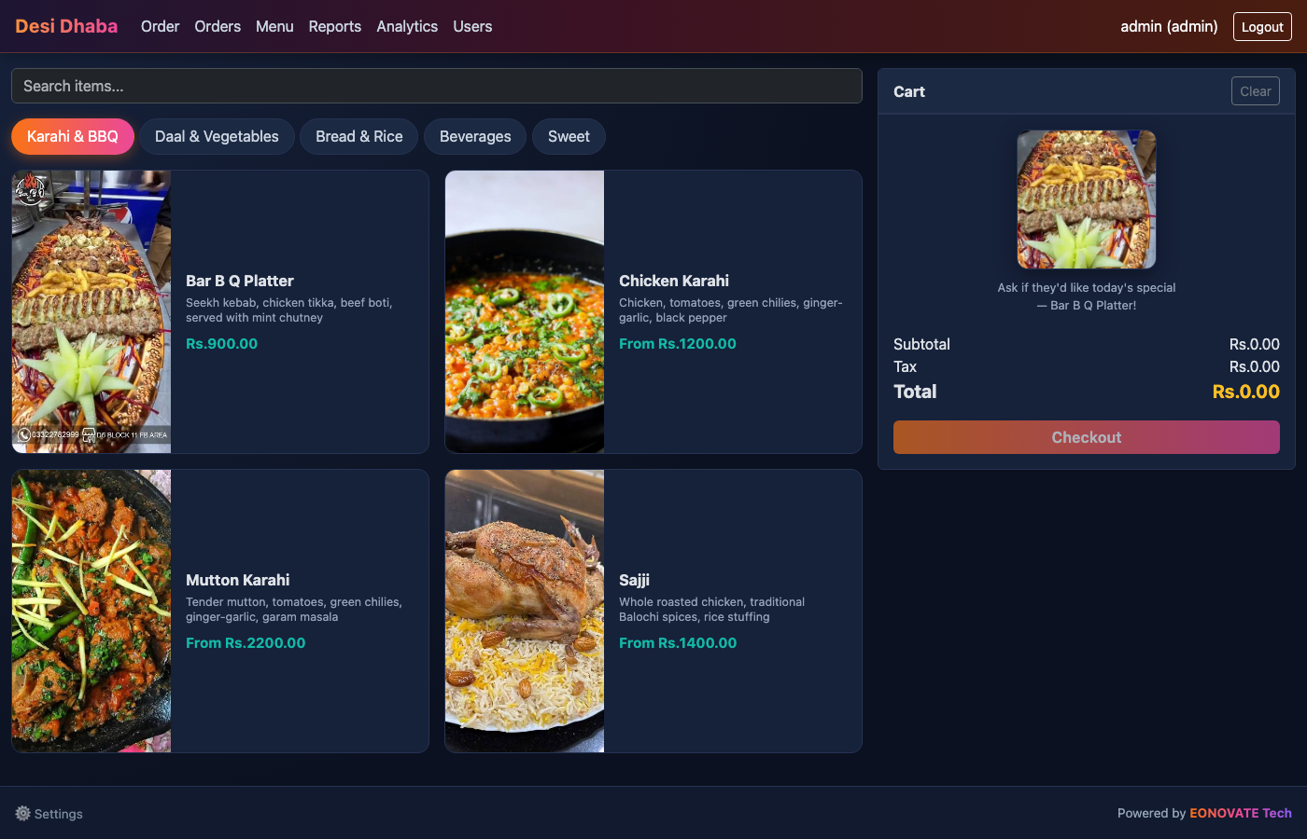
SEE IT IN ACTION
The order screen — a real menu book, not a grid of icons
Desi Dhaba POS · EONOVATE Tech
4

Slide 5
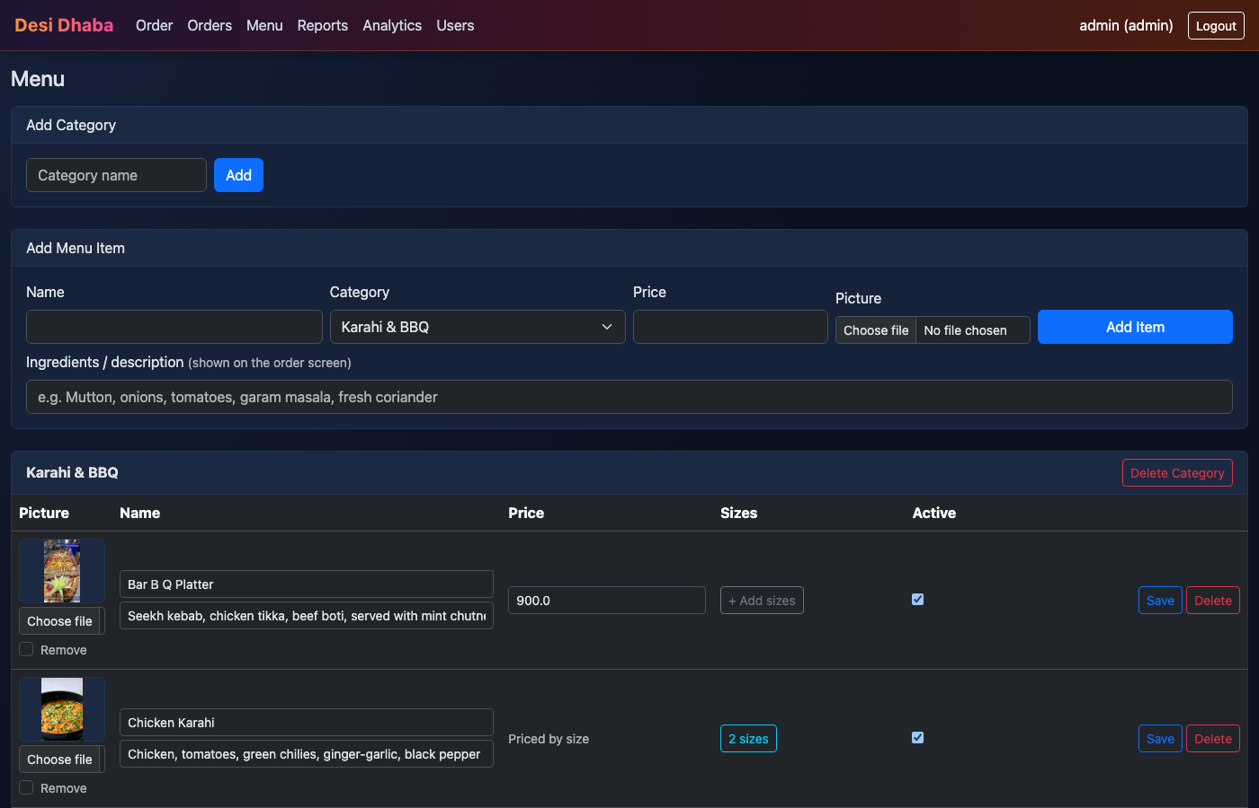
SEE IT IN ACTION
Restaurant owners manage their own menu — no developer needed
Why it matters
Upload a picture straight from a phone — validated and saved automatically
Edit name, price, sizes, and ingredients inline
Toggle items active/inactive for seasonal or sold-out dishes
Changes go live instantly on every till
Desi Dhaba POS · EONOVATE Tech
5

Slide 6
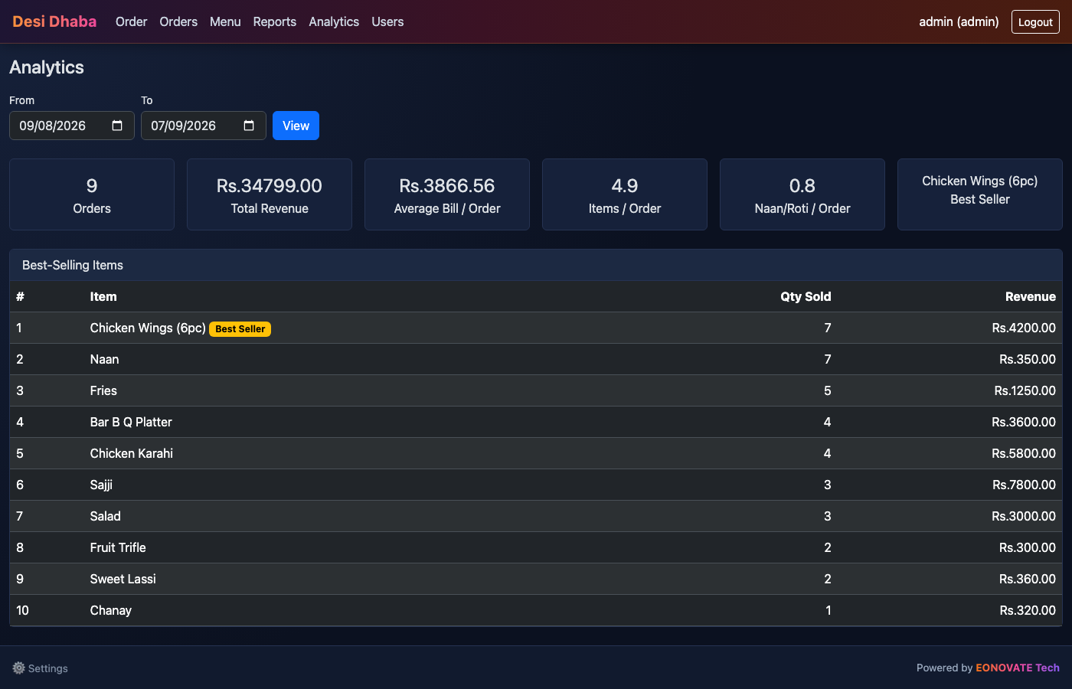
SEE IT IN ACTION
Analytics owners actually care about
Desi Dhaba POS · EONOVATE Tech
6

Slide 7
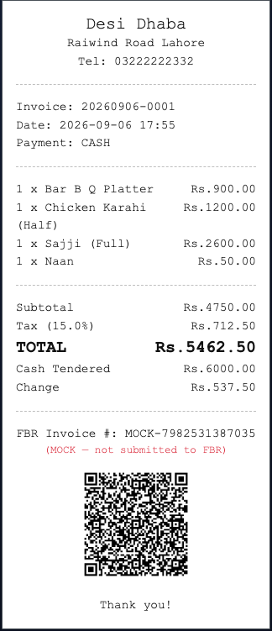
COMPLIANCE, BUILT IN
FBR-ready digital invoicing on every receipt
What's on the receipt
FBR invoice number and scannable QR code on every paid order
Ships in mock mode — fully demoable offline, no live FBR credentials needed
Flip to real mode in Admin > Settings once the restaurant has FBR POS credentials — no code changes
Prints on 58mm or 80mm thermal printers via USB, or falls back to a printable HTML receipt
Sales talking point: this is one feature many local competitors skip — lead with it.
Desi Dhaba POS · EONOVATE Tech
7

Slide 8
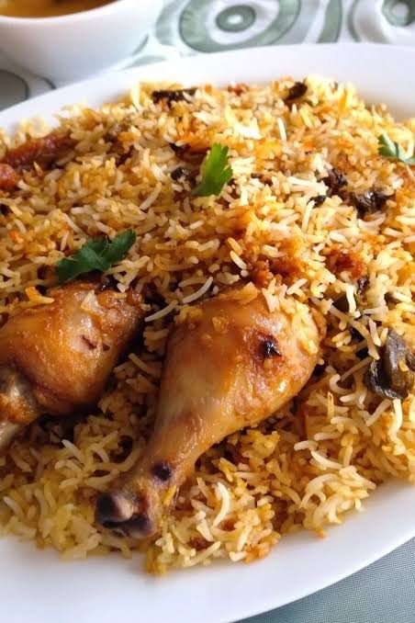
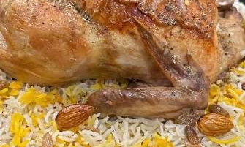
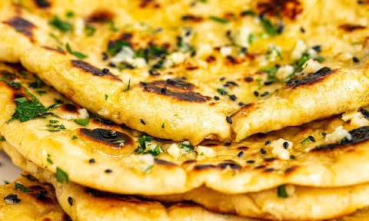

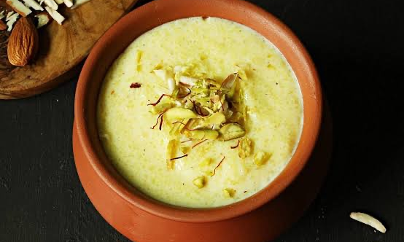
REAL FOOD, REAL PHOTOS
Every dish, exactly as the customer will see it
Mutton Karahi
Chicken Biryani
Sajji
Naan
Sweet Lassi
Firni
Desi Dhaba POS · EONOVATE Tech
8

Slide 9
WHY WE WIN
Built for Desi & Asian restaurants, not adapted from one template
Typical Local POS
Desi Dhaba POS
Menu presentation
Generic icon grids
Real photos + ingredients, menu-book layout
Tax compliance
Bolted on or missing
FBR mock + real invoicing, QR receipts built in
Kitchen insight
None, or a separate tool
Best sellers, bread/order, average bill — built in
Menu changes
Needs a developer
Owner manages menu & photos from Admin panel
Deployment
One-size-fits-all SaaS
Deployed and branded per restaurant
Desi Dhaba POS · EONOVATE Tech
9

Slide 10
NEXT STEPS
Let's get this in front of restaurant owners
Demo script: Order screen → Admin > Menu (upload a photo live) → Analytics → FBR receipt
Target: independent Desi/Asian restaurants and small chains currently on paper or a generic POS
Pricing & onboarding: [ Sales team to fill in ]
Contact: [ Sales team to fill in ]
Desi Dhaba POS · EONOVATE Tech
10

