Slide 1
FRESH · FAST · MADE TO ORDER
Restaurant POS System
Order, checkout, and FBR-ready digital invoicing — customizable for any restaurant.
Powered by EONOVATE Tech

Slide 2
Why This Exists
The Government of Pakistan now requires restaurants to issue digital invoices connected to FBR's Point-of-Sale integration — in real time, with an FBR invoice number and QR code on every receipt.
One system, reused for any restaurant or fast-food brand
Rebrand, change the menu, and set prices — entirely from the Admin panel, no code changes
Built-in FBR invoicing hook: works fully offline today (mock mode), flips to live FBR once onboarded
Powered by EONOVATE Tech
2

Slide 3
Key Features
Order & Cart
Sized Items
Category tabs, search, live cart with qty controls
Small / Medium / Large — each with its own price
Cash & Card Checkout
FBR Digital Invoicing
Auto change calculation, card reference capture
Every order gets an FBR invoice number + QR code
Thermal Printing
Admin Panel
ESC/POS receipts, with on-screen fallback if no printer
Menu, branding, tax, printer & FBR config, users, reports
Super-Admin Lock
Daily Sales Reports
A second credential gate protects Settings from staff
Cash vs card totals, tax collected, per-order detail
Powered by EONOVATE Tech
3

Slide 4
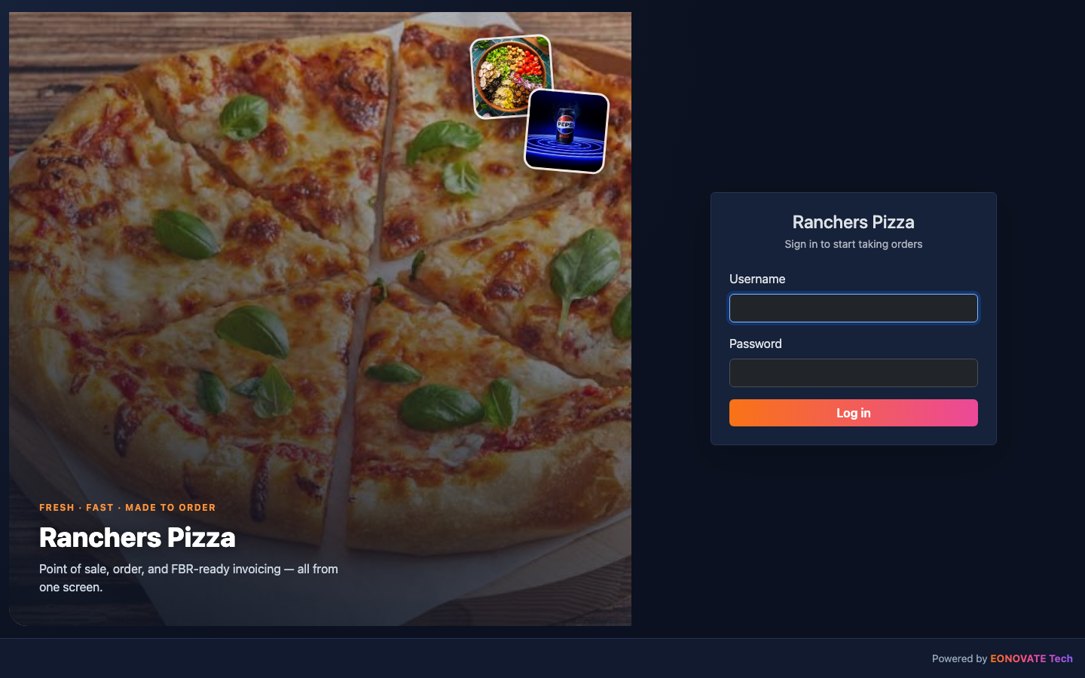
Login
Branded entry screen — restaurant name and imagery come from Settings
Powered by EONOVATE Tech
4

Slide 5
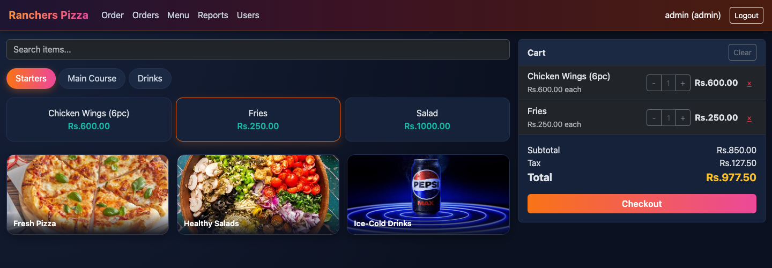
Order Dashboard
Category tabs, live search, and a running cart with tax breakdown
Powered by EONOVATE Tech
5

Slide 6
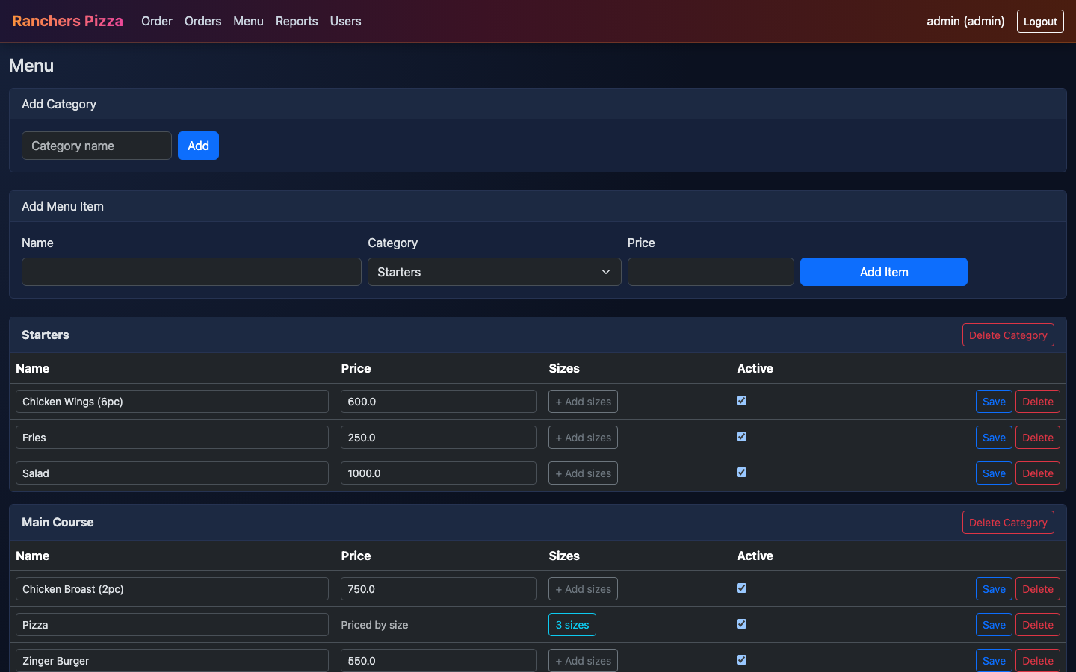
Menu Management
Add categories/items, set prices, or price an item by size
Powered by EONOVATE Tech
6

Slide 7
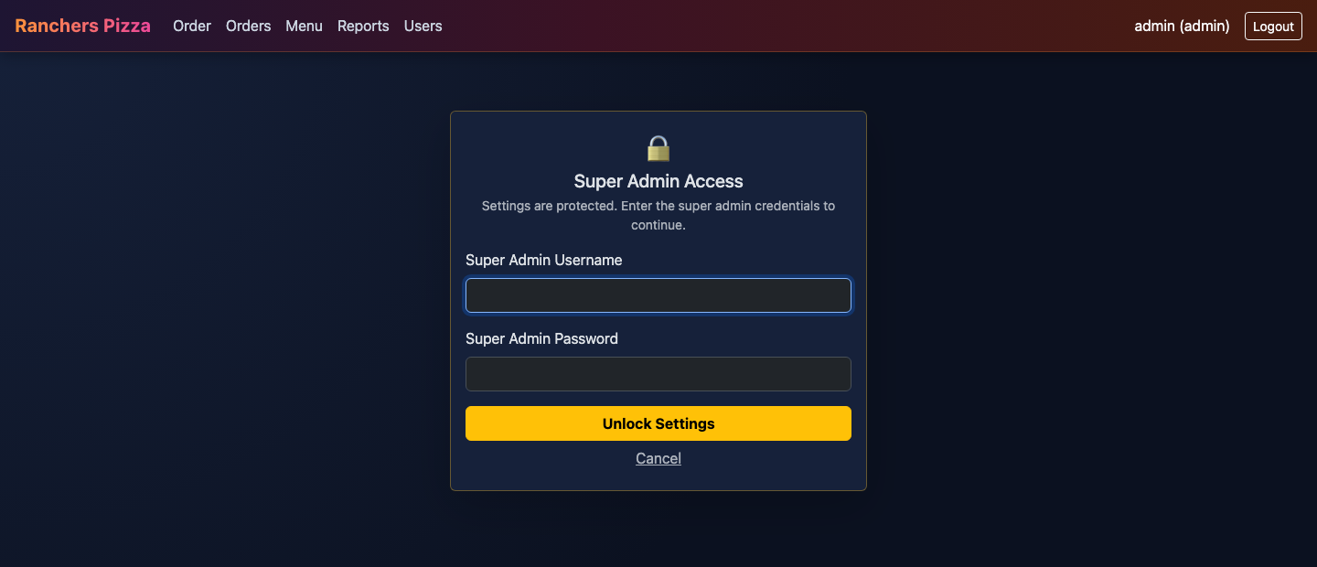
Protected Settings
A separate super-admin credential guards branding, tax, printer & FBR config
Powered by EONOVATE Tech
7

Slide 8
Built With
Flask
Python web app — blueprints for auth, ordering, admin
SQLite
Zero-setup, file-based database per restaurant deployment
Bootstrap 5
Dark, touch-friendly UI for tablet/till screens
python-escpos
Thermal receipt printing over USB
qrcode
FBR invoice QR codes, generated locally
Powered by EONOVATE Tech
8

Slide 9
Ready for any restaurant.
Rebrand it, load the menu, and start taking orders.
EONOVATE Tech

