Slide 1

EONOVATE TECH
Pak Capry Auto Spare Parts
Invoicing & Customer Account Management System
A desktop application built for Dubai, U.A.E. — Mac + Windows

Slide 2
PROJECT OVERVIEW
One app, the whole counter workflow
A Tkinter desktop app that runs the daily invoicing workflow end to end — from ringing up a sale to tracking which regular customers still owe a balance.
Sale Invoice
Customer Accounts
Item Management
Barcode/product lookup, VAT, discounts, one tap to a printed Tax Invoice.
A running tab per customer — charges and payments, one live balance.
The product catalog: add, price, and barcode every part you stock.
Reprint Invoice
Analytics
Secure Login
Pull up any past sale and reprint it, clearly marked Duplicate.
Sales trends and top items at a glance, straight from real invoice data.
Password-protected entry with a developer-gated reset flow.
02

Slide 3
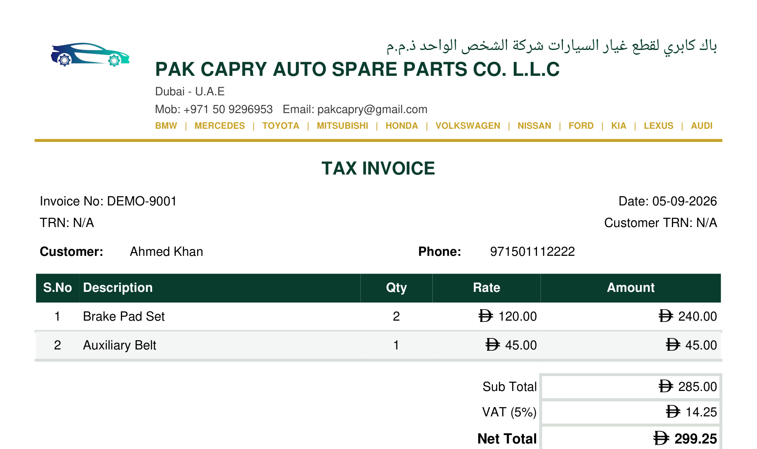
CORE WORKFLOW
Sale Invoice
▸ Scan a barcode or pick from the catalog — price and name fill in instantly
▸ New, uncatalogued items get added to stock the moment they're sold
▸ Live cart with quantity, discount, and optional 5% VAT
▸ One click saves the sale, prints a Tax Invoice PDF, and opens WhatsApp pre-filled to send it to the customer
03

Slide 4
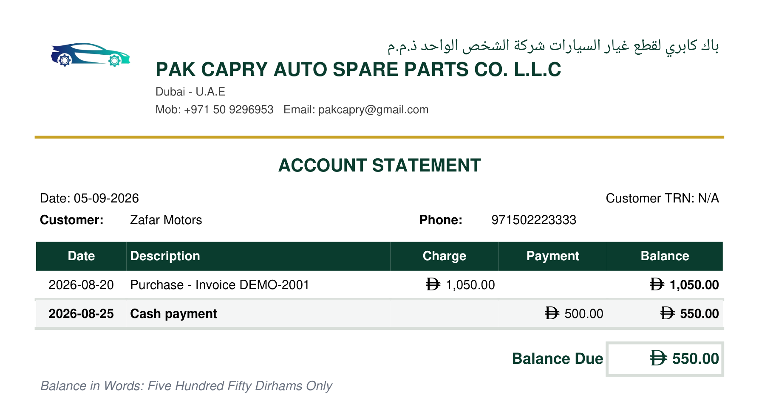
NEW THIS RELEASE
Customer
Accounts
▸ Search any customer by name or phone — type-to-filter, no memorizing numbers
▸ Every purchase and payment lands on one running ledger, oldest to newest
▸ The balance updates live: green when clear, red when they still owe
▸ A one-off sale from the regular Sale Invoice screen can become a running account later — its history comes along automatically
▸ Every change reissues one always-current Account Statement PDF
04

Slide 5
DELIVERY
Built around the client's own brand
Parrot Green Theme
Runs on Mac and Windows
Every screen, button, and chart uses the client's chosen brand color.
Packaged as native, standalone apps for both — no Python install needed on the shop's PC.
Custom Logo
Automatic Backups
The car-and-gears mark sits in every header, alongside the Pak Capry wordmark.
One click copies the full database to a timestamped backup file.
Bilingual Letterhead
Discoverable Output
Invoices print the Arabic company name above the English, matching the original paper letterhead.
Every invoice and statement PDF lands in one findable folder, ready to share over WhatsApp.
05

Slide 6
Pak Capry Auto Spare Parts Co. L.L.C
Dubai, U.A.E.
Developed by EONOVATE Tech

