Slide 1

JIV Voter Locator
Offline Voter Search & Constituency Management App
PP-167 Constituency • 112,000+ Voters Digitized • Fully Offline
Built by Eonovate
eonovatecore@gmail.com

Slide 2
OVERVIEW
From Paper Electoral Rolls to Instant Field Lookup
The Challenge
The Solution
● Official voter lists exist only as scanned, printed electoral roll PDFs
● Field workers need to find a voter’s house, block and details in seconds
● No reliable internet access in the field — a live web lookup isn’t an option
● Handwritten/OCR-scanned data is often noisy: smudged digits, misread characters
● A fully offline mobile app — the entire voter database ships inside the app
● Search any voter by CNIC or name in under a second, no signal required
● A verified, cleaned dataset: 55 scanned electoral roll files digitized and cross-checked against source PDFs
● A simple bilingual (Urdu/English) interface built for non-technical field staff
JIV Voter Locator • Eonovate
02

Slide 3
CAPABILITIES
What the App Can Do
Instant Search
Fully Offline
Add / Edit Records
Halqa & Polling Station
Look up any voter by CNIC or name, with results in real time.
The complete voter database is bundled on-device — zero internet dependency.
Field-add new voters or correct existing entries on the spot.
Every voter is mapped to its block code, halqa and polling station.
QR Code Scanning
Share & Export
Visit & Search Analytics
Bilingual RTL UI
Scan a CNIC or card to jump straight to a voter’s record.
Share a voter’s details via WhatsApp/SMS, or export filtered lists to PDF.
Tracks daily search volume and visit counts for reporting.
A native right-to-left Urdu interface throughout the app.
JIV Voter Locator • Eonovate
03

Slide 4
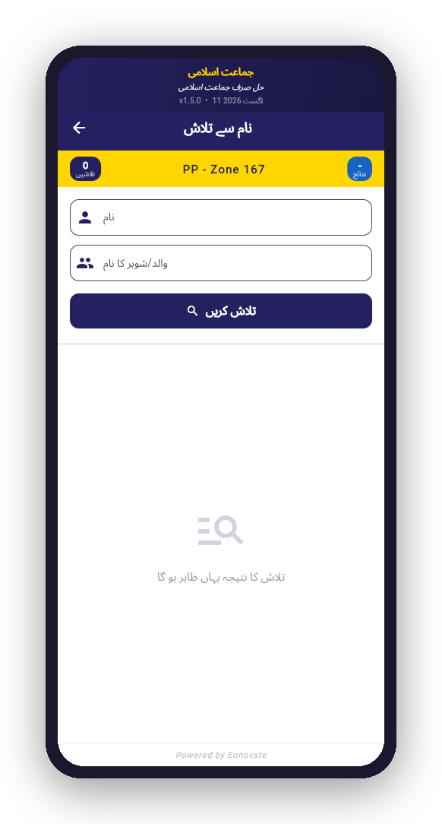
CAPABILITY — SEARCH
Find Any Voter in Seconds
● Search by name or CNIC number
● Instant, offline results — no network round-trip
● Zone/constituency banner keeps field staff oriented
● Clean empty-state guidance when no match is found
JIV Voter Locator • Eonovate
04

Slide 5
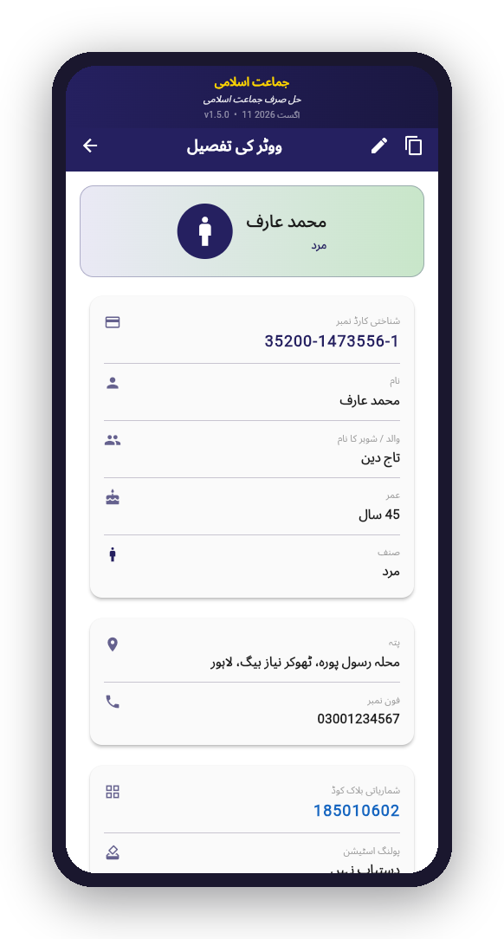
CAPABILITY — VOTER PROFILE
Complete Voter Detail at a Glance
● CNIC, name, father/husband name, age and gender
● Gender auto-detected from the CNIC’s check digit
● Full address plus household and serial numbers
● Block code and polling station linkage
● One-tap edit and share actions in the header
JIV Voter Locator • Eonovate
05

Slide 6
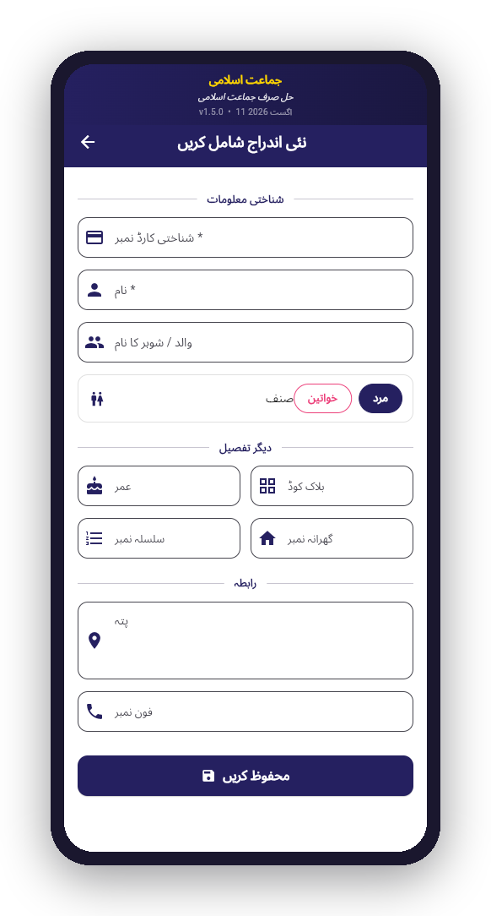
CAPABILITY — DATA ENTRY
Add or Correct Records in the Field
● Structured form for identity, contact and location details
● Built-in validation on required fields
● Gender toggle and CNIC-aware inputs
● Same form re-used for editing existing voters
JIV Voter Locator • Eonovate
06

Slide 7
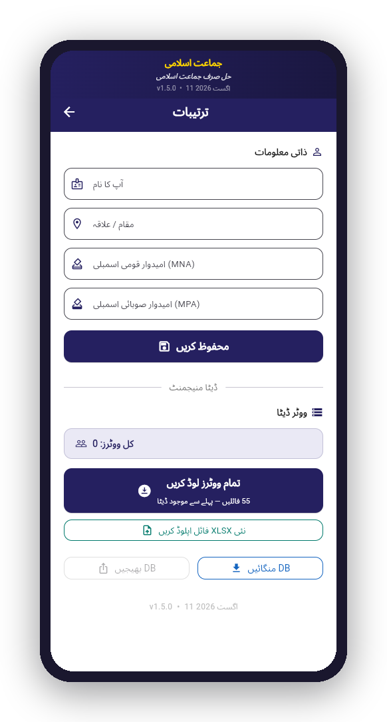
CAPABILITY — DATA MANAGEMENT
Offline-First Data, Fully Under Control
● 55 scanned electoral roll files bundled with the app
● One-tap bulk import of the entire constituency dataset
● Import additional XLSX files directly from the field
● Local database export/import for backup and handover
JIV Voter Locator • Eonovate
07

Slide 8
DATA ENGINEERING
A Verified, OCR-Cross-Checked Dataset
● 112,452 voter records digitized from 55 scanned PDF electoral rolls
● Custom OCR pipeline (Apple Vision framework) reads Serial No. and Household No. columns directly from the source scans
● Every automated correction is cross-verified against the original PDF page — not guessed from pattern-matching alone
● Structural integrity checks catch corrupt or malformed spreadsheet files before they ship
● Parser hardened so a single bad field never silently drops a real voter from search results
55
112,452
100%
Source Files
Voter Records
PDF-Verified Fixes
JIV Voter Locator • Eonovate
08

Slide 9
TECHNOLOGY
TECHNOLOGY
Built for Reliability in the Field
Built for Reliability in the Field
Flutter
SQLite (on-device)
Cross-platform app (Android / iOS) from a single codebase
Local, offline-first voter database — no server dependency
Excel/XLSX Import
Apple Vision OCR
Structured ingestion of electoral roll data at scale
Verifies and repairs numeric fields against source PDF scans
QR / Barcode Scanning
PDF Export & Share
mobile_scanner for fast CNIC lookup
Printable reports and WhatsApp/SMS sharing built in
JIV Voter Locator • Eonovate
09

Slide 10
Thank You
JIV Voter Locator — an Eonovate case study in offline-first field applications
eonovatecore@gmail.com

